Slide 1
pipelining
Unit 5

Slide 2
Parallel Processing
Parallel processing is a computing technique when multiple streams of calculations or data processing tasks co-occur through numerous central processing units (CPUs) working concurrently.
Parallel processing uses two or more processors or CPUs simultaneously to handle various components of a single activity. Systems can slash a program’s execution time by dividing a task’s many parts among several processors. Multi-core processors, frequently found in modern computers, and any system with more than one CPU are capable of performing parallel processing.
For improved speed, lower power consumption, and more effective handling of several activities, multi-core processors are integrated circuit (IC) chips with two or more CPUs. Most computers can have two to four cores, while others can have up to twelve. Complex operations and computations are frequently completed in parallel processing.

Slide 3
A parallel processing system can carry out simultaneous data-processing to achieve faster execution time. For instance, while an instruction is being processed in the ALU component of the CPU, the next instruction can be read from memory.
The primary purpose of parallel processing is to enhance the computer processing capability and increase its throughput, i.e. the amount of processing that can be accomplished during a given interval of time.
A parallel processing system can be achieved by having a multiplicity of functional units that perform identical or different operations simultaneously. The data can be distributed among various multiple functional units.

Slide 4
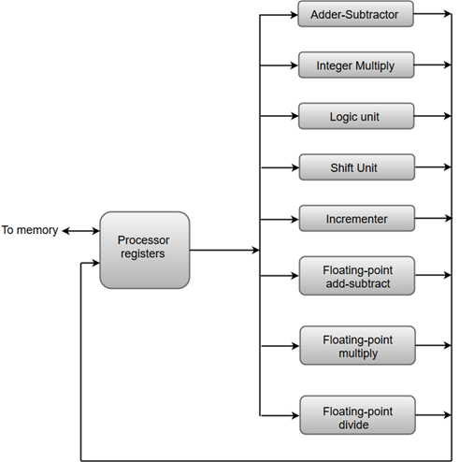
The diagram shows one possible way of separating the execution unit into eight functional units operating in parallel.
The adder and integer multiplier performs the arithmetic operation with integer numbers.
The floating-point operations are separated into three circuits operating in parallel.
The logic, shift, and increment operations can be performed concurrently on different data. All units are independent of each other, so one number can be shifted while another number is being incremented.

Slide 5
Flynn’s Classification
Single instruction stream, single data stream (SISD)
Single instruction stream, multiple data stream (SIMD)
Multiple instruction stream, single data stream (MISD)
Multiple instruction stream, multiple data stream (MIMD)

Slide 6
SISD
SISD stands for 'Single Instruction and Single Data Stream'. It represents the organization of a single computer containing a control unit, a processor unit, and a memory unit.
Instructions are executed sequentially, and the system may or may not have internal parallel processing capabilities.
Most conventional computers have SISD architecture like the traditional Von-Neumann computers.
Parallel processing, in this case, may be achieved by means of multiple functional units or by pipeline processing.
In SISD, a single processor is responsible for simultaneously managing a single algorithm as a single data source.

Slide 7
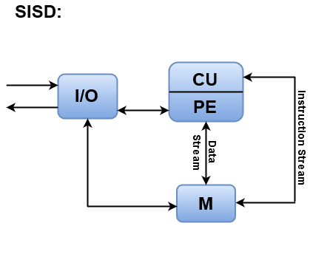
Where, CU = Control Unit, PE = Processing Element, M = Memory
Instructions are decoded by the Control Unit and then the Control Unit sends the instructions to the processing units for execution.
Data Stream flows between the processors and memory bi-directionally.
Examples:
Older generation computers, minicomputers etc

Slide 8
SIMD
SIMD stands for 'Single Instruction and Multiple Data Stream'. It represents an organization that includes many processing units under the supervision of a common control unit.
All processors receive the same instruction from the control unit but operate on different items of data.
The shared memory unit must contain multiple modules so that it can communicate with all the processors simultaneously.

Slide 9
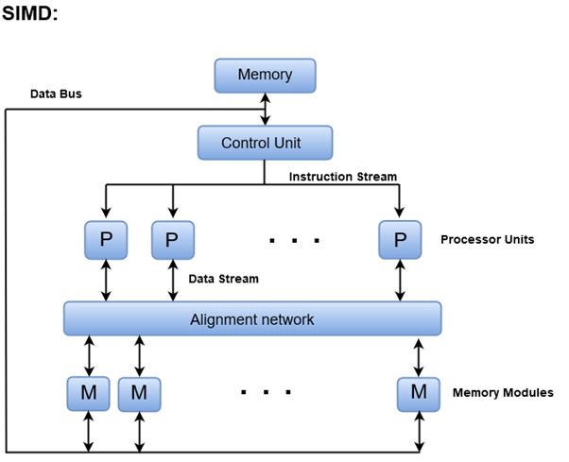

Slide 10
MISD
MISD stands for 'Multiple Instruction and Single Data stream'.
MISD structure is only of theoretical interest since no practical system has been constructed using this organization.
In MISD, multiple processing units operate on one single-data stream. Each processing unit operates on the data independently via separate instruction stream.
One processor’s output becomes the input for the following processor. This organization’s debut bring in little notice and wasn’t used in architecture.

Slide 11
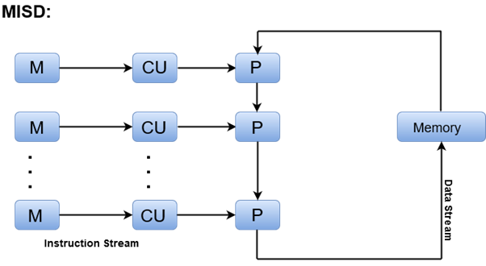
Where, M = Memory Modules, CU = Control Unit, P = Processor Units

Slide 12
MIMD
MIMD stands for 'Multiple Instruction and Multiple Data Stream'.
In this organization, all processors in a parallel computer can execute different instructions and operate on various data at the same time.
In MIMD, each processor has a separate program and an instruction stream is generated from each program.

Slide 13
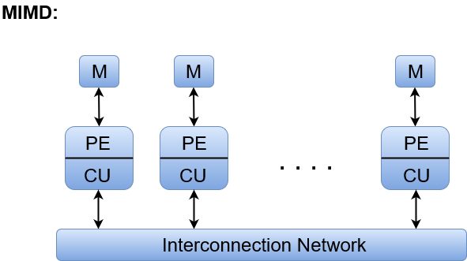
Where, M = Memory Module, PE = Processing Element, and CU = Control Unit
Examples:
Cray T90, Cray T3E, IBM-SP2

Slide 14
PIPELINING
Have you ever visited an industrial plant and see the assembly lines over there? How a product passes through the assembly line and while passing it is worked on, at different phases simultaneously. For example, take a car manufacturing plant. At the first stage, the automobile chassis is prepared, in the next stage workers add body to the chassis, further, the engine is installed, then painting work is done and so on.
The group of workers after working on the chassis of the first car don’t sit idle. They start working on the chassis of the next car. And the next group take the chassis of the car and add body to it. The same thing is repeated at every stage, after finishing the work on the current car body they take on next car body which is the output of the previous stage.
Here, though the first car is completed in several hours or days, due to the assembly line arrangement it becomes possible to have a new car at the end of an assembly line in every clock cycle.

Slide 15
In our computer system, in order to improve the performance of a CPU we have two options:
First option is to, improve the hardware by introducing faster circuits.
Second option it to arrange the hardware such that more than one operation can be performed at the same time.
Since there is a limit on the speed of hardware and the cost of faster circuits is quite high, 2nd option is the best one.

Slide 16
Pipelining is the process of storing and prioritizing computer instructions that the processor executes. The pipeline is a "logical pipeline" that lets the processor perform an instruction in multiple steps. The processing happens in a continuous, orderly, somewhat overlapped manner.
In computing, pipelining is also known as pipeline processing. It is sometimes compared to a manufacturing assembly line in which different parts of a product are assembled simultaneously, even though some parts may have to be assembled before others.
Even if there is some sequential dependency, many operations can proceed concurrently, which facilitates overall time savings.
Pipelining creates and organizes a pipeline of instructions the processor can execute in parallel.

Slide 17
The pipeline is divided into logical stages connected to each other to form a pipelike structure. Instructions enter from one end and exit from the other.
Pipelining is an ongoing, continuous process in which new instructions, or tasks, are added to the pipeline and completed tasks are removed at a specified time after processing completes.
The processor executes all the tasks in the pipeline in parallel, giving them the appropriate time based on their complexity and priority. Any tasks or instructions that require processor time or power due to their size or complexity can be added to the pipeline to speed up processing.

Slide 18
How pipelining works
Without a pipeline, the processor would get the first instruction from memory and perform the operation it calls for. It would then get the next instruction from memory and so on. While fetching the instruction, the arithmetic part of the processor is idle, which means it must wait until it gets the next instruction. This delays processing and introduces latency.
With pipelining, the next instructions can be fetched even while the processor is performing arithmetic operations. These instructions are held in a buffer close to the processor until the operation for each instruction is performed. This staging of instruction fetching happens continuously, increasing the number of instructions that can be performed in a given period.
Within the pipeline, each task is subdivided into multiple successive subtasks. A pipeline phase is defined for each subtask to execute its operations. Like a manufacturing assembly line, each stage or segment receives its input from the previous stage and then transfers its output to the next stage. The process continues until the processor has executed all the instructions and all subtasks are completed.

Slide 19
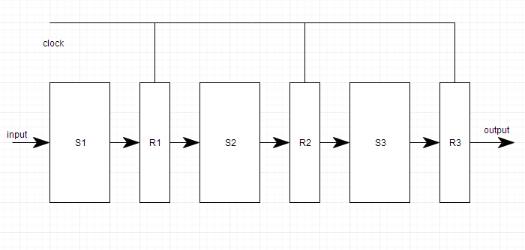
In the pipeline, each segment consists of an input register that holds data and a combinational circuit that performs operations. The output of the circuit is then applied to the input register of the next segment of the pipeline. Here are the steps in the process:
Fetch instructions from memory.
Read the input register, and decode the instruction.
Execute the instruction.
Access an operand in data memory.
Write the result of the operation into the input register of the next segment.

Slide 20
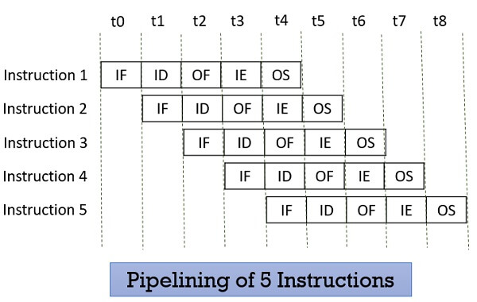


Slide 21
Speedup Equation
The speedup equation in pipelining is a measure of how much faster a pipelined architecture can execute instructions compared to a non-pipelined architecture.
It's a fundamental concept in computer architecture, and the basic idea is to divide the execution of instructions into separate stages, allowing multiple instructions to be processed simultaneously. The speedup S is given by:
S=T1/Tp
where:
T1 is the execution time of the program without pipelining (single-stage).
Tp is the execution time of the program with pipelining.
In ideal conditions, the speedup can also be approximated by the number of pipeline stages k if we assume no pipeline stalls and perfect conditions:
S≈k

Slide 22
Example:
Suppose we have a non-pipelined processor that takes 5 clock cycles to execute one instruction. Now, let's say we design a pipelined processor with 5 stages, where each stage takes 1 clock cycle to complete.
Non-Pipelined Processor:
Execution time for 1 instruction: 5 clock cycles.
Execution time for 4 instructions: 4 instructions × 5 clock cycles = 20 clock cycles.
Pipelined Processor:
Execution time for the first instruction: 5 clock cycles (each stage takes 1 cycle).
After the first instruction, each subsequent instruction completes in 1 clock cycle (because they are processed simultaneously in the pipeline).
Execution time for 4 instructions: 5 clock cycles (for the first instruction) + 3 clock cycles (for the next 3 instructions) = 8 clock cycles.

Slide 23
Speedup Calculation:
Without pipelining: Total execution time = 20 clock cycles.
With pipelining: Total execution time = 8 clock cycles.
Speedup S is given by:
S=T1/Tp
=20 clock cycles / 8 clock cycles
=2.5
So, the pipelined processor is 2.5 times faster than the non-pipelined processor in this example

Slide 24
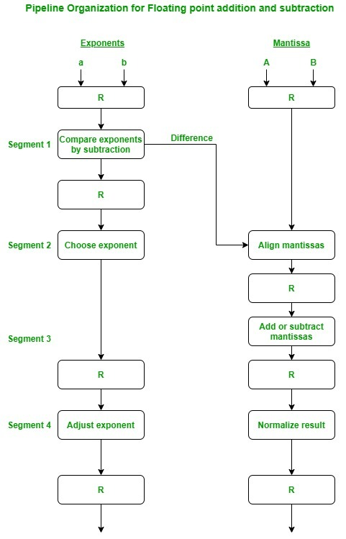
1. Arithmetic Pipeline :
An arithmetic pipeline divides an arithmetic problem into various sub problems for execution in various pipeline segments.
It is used for floating point operations, multiplication and various other computations.
The process or flowchart arithmetic pipeline for floating point addition is shown in the diagram.

Slide 25
Floating Point Addition and subtraction
The following sub operations are performed in this operation:
Compare the exponents.
Align the mantissas.
Add or subtract the mantissas.
Normalise the result
First of all the two exponents are compared and the larger of two exponents is chosen as the result exponent. The difference in the exponents then decides how many times we must shift the smaller exponent to the right. Then after shifting of exponent, both the mantissas get aligned. Finally the addition or subtraction of both numbers take place followed by normalisation of the result in the last segment.

Slide 26
Example:
Let us consider two numbers,
X=0.3214*10^3 and Y=0.4500*10^2
Explanation:
First of all the two exponents are subtracted to give 3-2=1. Thus 3 becomes the exponent of result and the smaller exponent is shifted 1 times to the right to give
Y=0.0450*10^3
Finally the two numbers are added to produce
Z=0.3664*10^3
As the result is already normalized the result remains the same.

Slide 27
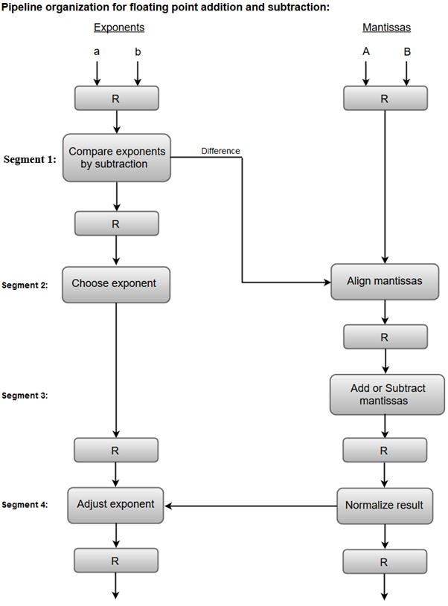
Example
X = 0.9504 * 10³
Y = 0.8200 * 10²

Slide 28
1. Compare exponents by subtraction:
The exponents are compared by subtracting them to determine their difference. The larger exponent is chosen as the exponent of the result.
The difference of the exponents, i.e., 3 - 2 = 1 determines how many times the mantissa associated with the smaller exponent must be shifted to the right.
2. Align the mantissas:
The mantissa associated with the smaller exponent is shifted according to the difference of exponents determined in segment one.
X = 0.9504 * 10³ Y = 0.08200 * 10³
3. Add mantissas:
The two mantissas are added in segment three.
Z = X + Y = 1.0324 * 10³
4. Normalize the result:
Z = 1.0324 * 10^{3 (Already Normalised)}

Slide 29
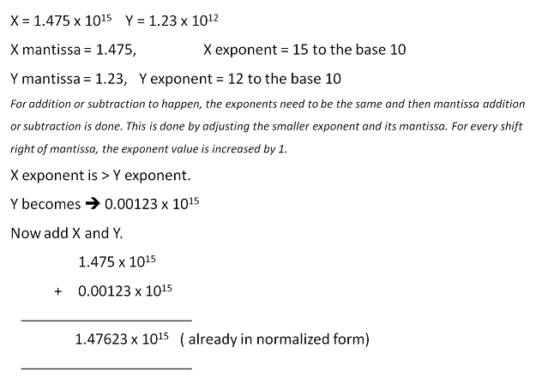

Slide 30
Instruction level pipelining
In instruction pipelining, a stream of instructions can be executed by overlapping fetch, decode and execute phases of an instruction cycle. This type of technique is used to increase the throughput of the computer system.
An instruction pipeline reads instruction from the memory while previous instructions are being executed in other segments of the pipeline. Thus we can execute multiple instructions simultaneously.
The pipeline will be more efficient if the instruction cycle is divided into segments of equal duration.

Slide 31
Pipeline processing can happen not only in the data stream but also in the instruction stream. To perform tasks such as fetching, decoding and execution of instructions, most digital computers with complicated instructions would require an instruction pipeline.
In general, each and every instruction must be processed by the computer in the following order:
1. Fetching the instruction from memory
2. Decoding the obtained instruction
3. Calculating the effective address
4. Fetching the operands from the given memory
5. Execution of the instruction
6. Storing the result in a proper place
Each step is carried out in its own segment, and various segments may take different amounts of time to process the incoming data. Furthermore, there are occasions when multiple segments request memory access at the very same time, requiring one segment to wait unless and until the memory access of another is completed.
If the instruction cycle is separated into equal-length segments, the organisation of an instruction pipeline will become much more efficient. A four-segment type of instruction pipeline refers to one of the most common instances of this style of organisation.

Slide 32
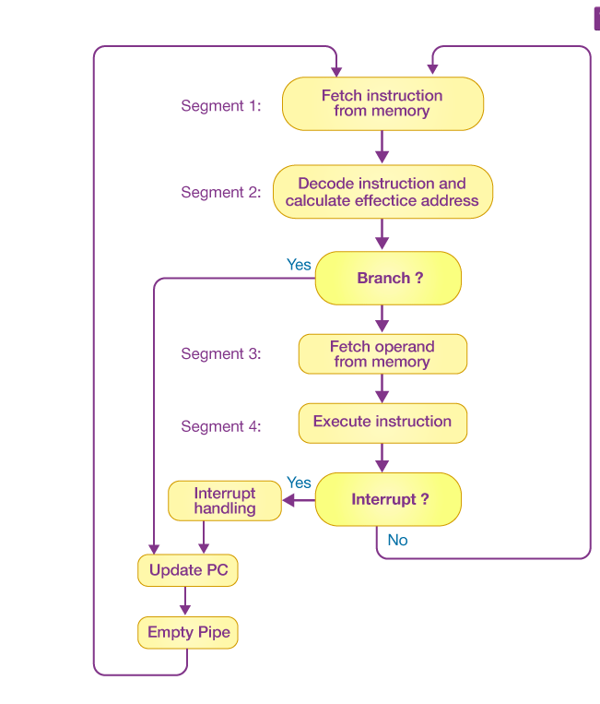
A four-segment instruction pipeline unifies two or more distinct segments into a single unit. For example, the decoding of the instruction and the calculation of the effective address can be merged into a single segment.
Segment 1
The implementation of the instruction fetch segment can be done using the FIFO or first-in, first-out buffer.
Segment 2
In the second segment, the memory instruction is decoded, and the effective address is then determined in a separate arithmetic circuit.
Segment 3
In the third segment, some operands would be fetched from memory.
Segment 4
The instructions would finally be executed in the very last segment of a pipeline organisation.

Slide 33
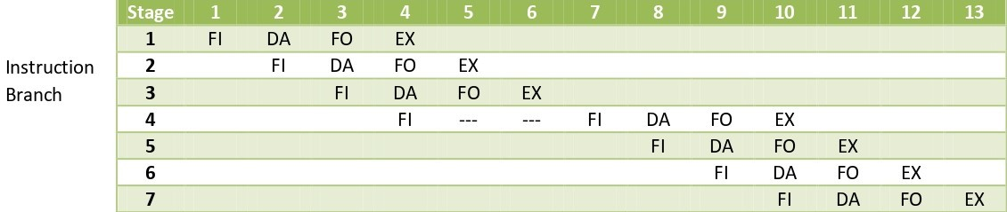
Here the instruction is fetched on first clock cycle in segment 1. Now it is decoded in next clock cycle, then operands are fetched and finally the instruction is executed. We can see that here the fetch and decode phase overlap due to pipelining.
By the time the first instruction is being decoded, next instruction is fetched by the pipeline. In case of third instruction we see that it is a branched instruction. Here when it is being decoded 4th instruction is fetched simultaneously.
But as it is a branched instruction it may point to some other instruction when it is decoded. Thus fourth instruction is kept on hold until the branched instruction is executed.
When it gets executed then the fourth instruction is copied back and the other phases continue as usual.

Slide 34
Pipeline conflicts
Timing Variations
All stages cannot take same amount of time. This problem generally occurs in instruction processing where different instructions have different operand requirements and thus different processing time.
Data Hazards
When several instructions are in partial execution, and if they reference same data then the problem arises. We must ensure that next instruction does not attempt to access data before the current instruction, because this will lead to incorrect results.
Branching
In order to fetch and execute the next instruction, we must know what that instruction is. If the present instruction is a conditional branch, and its result will lead us to the next instruction, then the next instruction may not be known until the current one is processed.

Slide 35
Interrupts
Interrupts set unwanted instruction into the instruction stream. Interrupts effect the execution of instruction.
Data Dependency
It arises when an instruction depends upon the result of a previous instruction but this result is not yet available.
Resource Limitation
If the two instructions request for accessing the same resource in the same clock cycle, then one of the instruction has to stall and let the other instruction to use the resource. This stalling is due to resource limitation. However, it can be prevented by adding more hardware.

Slide 36
Pipeline conflicts solution
Hardware Interlocks − Hardware interlocks are electronic circuits that detect instructions whose source operands are destinations of instructions further up in the pipeline. After detecting this situation, the instruction whose source is not available is delayed by a suitable number of clock periods. In this way, the conflict is resolved.
Operand Forwarding − This procedure need special hardware to identify a conflict and then prevent it by routing the information through a unique direction between pipeline segments. This approach needed additional hardware direction through MUXs (multiplexers).
Example:
Instruction A: ADD R1, R2, R3 (produces result in R1)
|
Forward Result
|
Instruction B: SUB R4, R1, R5 (needs R1 from Instruction A)
In this example, instead of waiting for Instruction A to write the result to R1, Instruction B gets the result directly from the pipeline stage where Instruction A produced it.

Slide 37
Branch Prediction − This method utilizes some sort of intelligent forecasting through appropriate logic. A pipeline with branch prediction guesses the result of a conditional branch instruction before it is implemented. The pipeline fetches the stream of instructions from a predicted path, thus saving the time that is wasted by branch penalties.

Slide 38
The End

